Slide 1
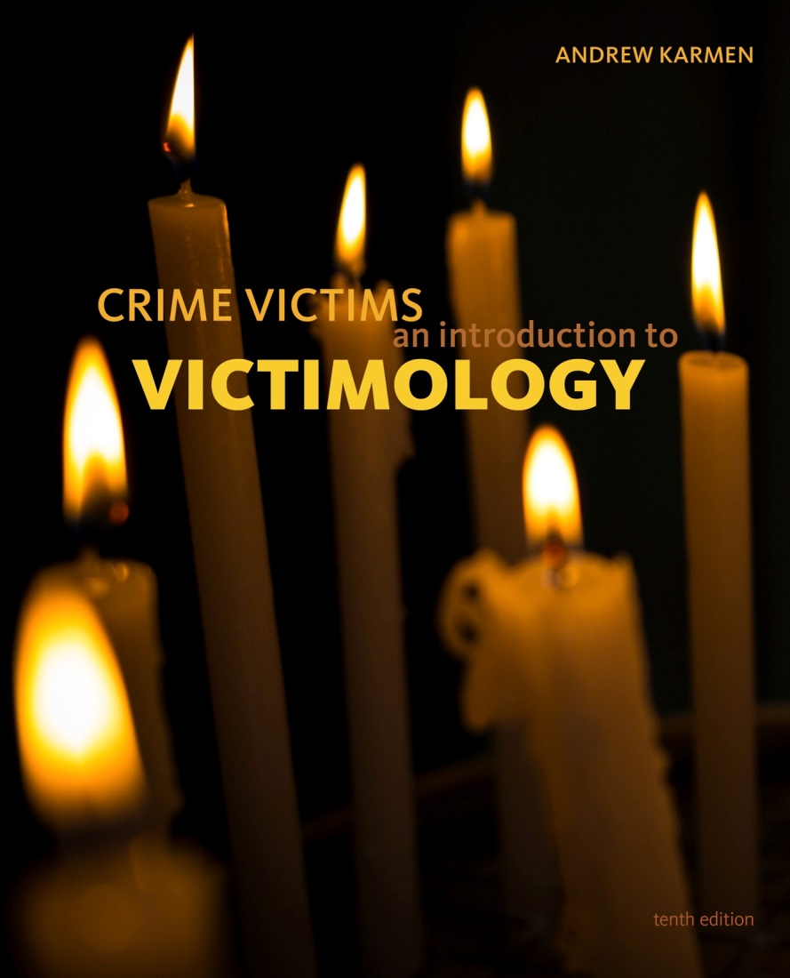

Crime Victims An Introduction to Victimology
Chapter 9
Victims of Violence by Lovers and Family Members
© 2020 Cengage. All rights reserved.

Slide 2
Learning Objectives (1 of 2)
L01. Distinguish between the different forms of violence by lovers and family members
L02. Summarize the rediscovery of “wife beating” and shifts in attitudes and responses toward battered women.
L03 Differentiate victim-blaming, victim-defending, and system-blaming arguments
L04. Contrast maximalist and minimalist perspectives on the problem of intimate partner violence.
L05. Explain why battered women remain in troubled relationships.
L06. Identify different forms of elder abuse.
L07. Explain the different strategies underlying prevention efforts to reduce violence within families.

Slide 3
Violence within Romantic relationships and families

Slide 4
Nonstranger Interpersonal Violence
Victims and their assailants
  Live in close proximity
  Routinely interact with each other
  Are mutually dependent
Term domestic disturbance has been replaced with intimate partner violence (IPV)

Slide 5
THE REDISCOVERY OF “WIFE BEATING”

Slide 6
Most Studied Victim–Offender Relationship
Historically, the patriarchy allowed a man to beat his wife and children—his property
In 1600s, Puritans forbid violence by law
  Moderate correction within domestic chastisement
  Rule of thumb-originated from a guideline that men could not use a stick bigger around than their thumb to chastise their wives
  Laws were social controls—symbolism over function
First wave of reform: 1800s, temperance movement
Second wave: 1970s, women’s liberation movement
  Shattered the illusion of domestic tranquility

Slide 7
Victim Blaming versus Victim Defending
Blaming her for his violent outbursts
  Emphasizes her shortcomings
  His problem is his weakness
  Entire burden of change is on her
  This view fails to condemn violence
Defending her from blame
  He beats to exert his power (via conventional sex roles)
  She does not deserve harm
  Wife beating is a social problem and requires intervention

Slide 8
How Victims Suffer
CDC identifies four types of behavior under IPV
  Psychological and emotional aggression
  Stalking, spying, menacing, threatening
  Sexual violence
  Physical violence
IPV can cause
  Emotional harm
  Physical injuries
  Self-destructive habits

Slide 9
Estimates of Incidence, Prevalence, and Seriousness of Intimate Partner Violence (1 of 3)
Evidence from the 1970s was anecdotal
  Information from speak-outs where victims told their stories
Methodological problems with data collection
  Which relationships should be included or excluded?
  How are the data collected?
  What behaviors constitute abuse?
  What defines the use of force?
    There is normative ambiguity about what constitutes “violence” between intimates

Slide 10
Estimates of Incidence, Prevalence, and Seriousness of Intimate Partner Violence (2 of 3)
Maximalist arguments
  Women more likely harmed by intimates than strangers
  IPV affects one in four women; one in seven men
  53 percent of incidents not reported to police
  Cycle of violence increases over time
  Women sustain over 2 million injuries from IPV yearly
  Social costs equal about $5–$10 billion yearly
  Leading cause of female homelessness

Slide 11
Estimates of Incidence, Prevalence, and Seriousness of Intimate Partner Violence (3 of 3)
Minimalist arguments
  Definition of violence is overly broad and inflates scope of problem
  Most IPV inflicts no wounds
  Murders by intimates are rare
  2016 NCVS data show 2 per 1,000 interviewees report assaults
  Some reported incidents are threats or simple assaults that failed
  NCVS data indicate that IPV is diminishing

Slide 12
Recognizing Warning Signs
Statistical profile of a couple in which the woman is at risk for a severe beating
  Woman is aged 18–34, unemployed, poorly educated, lives with a man of a different religious or ethnic background
  Man is aged 18–30, unemployed or blue-collar, poorly educated, abusive to his children, heavy drinker
Highest risk groups include
  African-American women, between 18 and 34 years old, separated, head of households

Slide 13
Fatal Attractions: Slayings of Intimate Partners
FBI’s SHRs (supplemental homicide reports) show
  16 percent of murders arose out of IPV
  40 percent of female murder victims are slain by intimates
  Percentages of murders involving married people are declining whereas percentages involving unmarried intimates are rising

Slide 14
Use your critical thinking skills to consider….
What are some possible reasons to explain why the number of murders of spouses has dropped so sharply over recent decades, while the slaying of girlfriends and boyfriends actually has gone up?

Slide 15
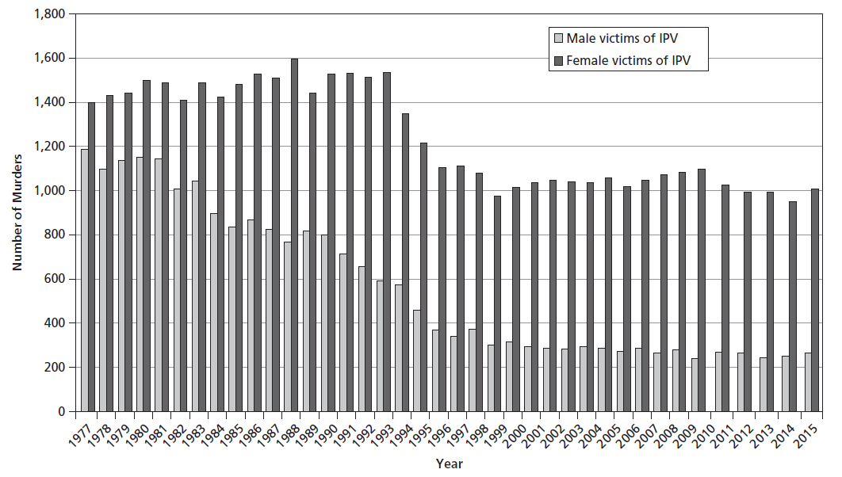
Figure 9.1 Trends in Murders Due to Intimate Partner Violence, United States, 1977–2015

Slide 16
Explaining IPV: Why Doesn’t She Just Leave Him?
Battered woman syndrome: Three-phase cycle of violence and learned helplessness
  Tension building
  The violent explosion
  Reconciliation --Tranquil loving aftermath
Plausible reasons women stay with violent mates
  Dependence
  Fear of reprisals, especially for their children
  Loyalties to marriage vows
  Shame
  Practical considerations like common property

Slide 17
Enabling Victims Who Feel Trapped to Escape
Priority of battered woman’s movement to provide aid
  Established shelters, self-help groups, counseling, and educational services
Government-sponsored shelters spread in 1980s
  “Pro-family” sought to limit government funding
Women seeking shelters suffer 60–70 beatings yearly
2016: 1,560 shelters house 13,000 women and 13,000 children each day
  Filled to capacity
    Wait lists
    Time limits on stays

Slide 18
Battered Women and the Criminal Justice System: Violence Is Violence—or Is It? (1 of 3)
Preserve-the-family model, 1950s and 1960s
  Based on shared responsibility
  Long-term counseling to strengthen marital bond
Legalistic model, 1980s to today
  Separates the parties involved
  Rescue and protect the injured
  Punish and rehabilitate the aggressor

Slide 19
Battered Women and the Criminal Justice System: Violence Is Violence—or Is It? (2 of 3)
Police response
  Past response was to arrest if stitches were necessary
  Arrests from mandatory directives show mixed results
  Probable cause arrests are allowed when injuries are visible, a weapon was used, or violence will continue
Prosecutorial response
  Past response was to discourage pressing of charges
  Most cases are dismissed or negotiated down
  Goal is to better deal with “flip-flopping” victims
    No-drop approach

Slide 20
Battered Women and the Criminal Justice System: Violence Is Violence—or Is It? (3 of 3)
Judicial response
  Set bail as needed or speed up case processing
  Evict abuser from the household
  Issue orders of protection or restraining orders
    Grant immediate relief, prevent further attacks
Legislative response
  Restricted use of the parental alienation argument
  Landlords cannot penalize women who break leases
  Grant civil orders of protection to unmarried couples
  Gun surrender laws

Slide 21
The rediscovery Of battered husbands and boyfriends

Slide 22
Husband Beating
Rediscovered in the 1970s
  Journal articles indicated that 28 percent of females and 22 percent of males perpetrated IPV
Battered men face unique problems
  Authorities disbelieve or mock them
  Inadequate resources—shelters, support groups, etc.
Most battered men can support themselves, which enables them to leave troubled relationships

Slide 23
Victim provocation and murder: when is the slaying of a wife beater justified?

Slide 24
Intimate Partner Homicides and the Criminal Justice System
When a battered woman kills her batterer
  Legal perspective
    She is the offender
    He is the victim
  Victims’ rights movement
    Dead men are the aggressors
    Battered women should not be jailed

Slide 25
Arguments Stressing That the Brutal Man Did Not Deserve to Die
Victim defending leads to offender blaming
  His actions did not justify murder
  She must be punished for a crime
Battered woman had a duty to retreat
  She stood her ground, engaging in mutual combat
Self-defense does not include killing unconscious men
  Vigilante justice, revenge cannot be condoned
  Batterer’s side of the story cannot be known or told

Slide 26
Arguments Emphasizing That the Brutal Man Provoked the Lethal Response
Killing was self-defense, not revenge
  Justifiable homicides
Men killed by victims are more abusive than typical batterers
Battered women who kill are different from others
  More isolated socially and economically
  Suffered more severe beatings
  Had children who were abused
  Partners were heavy drinkers

Slide 27
Legal Questions
Charges can range from nothing to first-degree murder
Most cases are resolved with woman pleading to lesser charges
Pleas of not guilty by reasons of diminished capacity or temporary insanity
  Offer excuses for the act
  Concede that taking the man’s life was wrong
Victim blamers prefer self-defense arguments
  Past experience matters
All crimes are socially defined

Slide 28
Use your critical thinking skills…….
Movies like “Sleeping with the Enemy” and streaming series like “Big Little Lies” portray the murder of abusers by others. The prevailing viewer attitude is that the murders were justifiable. Why do you think these shows are presented as entertainment? Do you think they are meant to change societal norms concerning violence? The victim–victimizer relationship?

Slide 29
The rediscovery of other victims of beatings

Slide 30
Dating Violence
Occurs in person and electronically
Experienced by 20 percent to 33 percent of teenagers; 10 percent to 50 percent of college students
Assaulting peaks at 20 years old, gradually declining
Differs from marital violence
  Less force over shorter periods of time
  Women are more likely to initiate violence
Why do young women remain with abusers?
  Jealousy is seen as a sign of intense feelings
  Violence is the norm of behavior

Slide 31
Abuse of Parents by Adolescents
Estimates are confounded by severe underreporting
May be due to an intergenerational cycle of violence
Physically aggressive fathers with drinking problems are the most likely targets

Slide 32
Elder Abuse
Elder abuse rediscovered in the 1970s-Victim's tend to live with and depend on the abuser
Adult protective service agencies investigate
Acts of commission
  Physical assaults, extortion, confinement
Acts of omission
  Failure to provide food, clothing, shelter, medicine
Differential risks include
  Mental illness or physical frailties
  Limited income in large households
  African American

Slide 33
Battering within Same-Sex Relationships
25 percent to 35 percent of same-sex couples experience IPV
Bisexual women and lesbians suffer disproportionally more than heterosexual women
Violence is underreported and unacknowledged
  Fear of being outed
  Ineffective police response
  Fuels homophobia
  Undercuts the women’s movement

Slide 34
Use your critical thinking skills……
Under what circumstances, if any, could the killing of a vicious wife beater by his victim be ruled a justifiable homicide, in your opinion?

Slide 35
Preventing domestic violence

Slide 36
Preventing Battering
Primary prevention programs
  Head off a resort to physical force by refuting myths, challenging stereotypes, and changing attitudes.
Secondary prevention programs
  Attempt to teach high-risk couples negotiation skills and anger management techniques
System blamers
  Encourage help-seeking behaviors
  Want improved security

Slide 37
Policy Implications….
Comprehensive approach
  Remove burden of behavioral changes and of finding relief from victims
  Criminal justice system should intervene
  Change attitudes that condone violence

